Slide 1
CSE 471: MACHINE LEARNING
Optimizations

Slide 2
Gradient descent variants

Slide 3

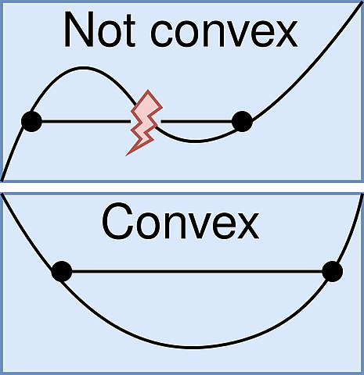
Batch Gradient Descent
Does not allow for online updates
Guaranteed to converge to
  Global minimum for convex error surfaces
  Local minimum for non-convex surfaces
Image taken from: Wikipedia

Slide 4
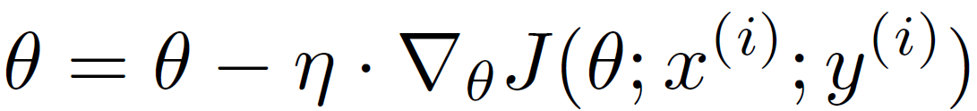
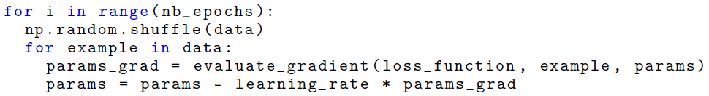
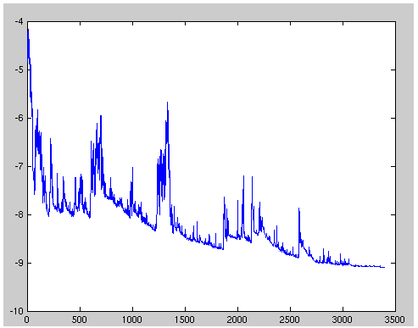
Stochastic gradient descent
Can be used to learn online
Performs frequent updates, albeit with high variance
Can jump to new and potentially better local minima
Image taken from: Wikipedia

Slide 5
Stochastic gradient descent
Problem
  Complicates convergence to the exact minimum, as SGD will keep overshooting.
Solution
  Slowly decrease the learning rate
  Results in same convergence behaviour as batch gradient descent

Slide 6
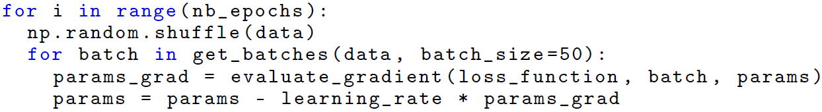
Mini-batch gradient descent
Reduces the variance of the parameter updates
  Leads to more stable convergence;
Can make use of highly optimized matrix optimizations
  Benefits from GPU usage

Slide 7
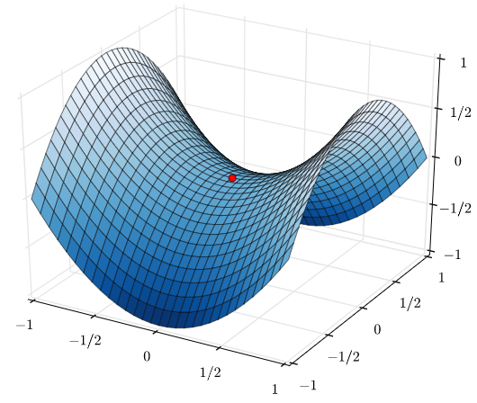
Mini-batch gradient descent
Challenges
  Choosing proper learning rate is hard
  Same learning rate is applied to all parameters
  Can get trapped into local minima or saddle points
Saddle Point is a point on the surface of the graph of a function where the slopes (derivatives) in orthogonal directions are all zero (a critical point), but which is not a local extremum of the function.
Image taken from: Wikipedia (Nicoguaro - Own work)

Slide 8
Gradient descent optimization

Slide 9
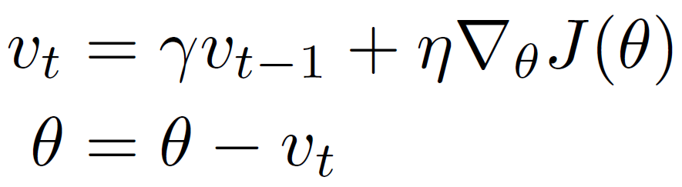
Momentum
The momentum term ϒ is usually set to 0.9
When using momentum, we push a ball down a hill. The ball accumulates momentum as it rolls downhill, becoming faster and faster on the way (until it reaches its terminal velocity, if there is air resistance, i.e. ϒ < 1)
The momentum term increases for dimensions whose gradients point in the same directions and reduces updates for dimensions whose gradients change directions.
As a result, we gain faster convergence and reduced oscillation.

Slide 10
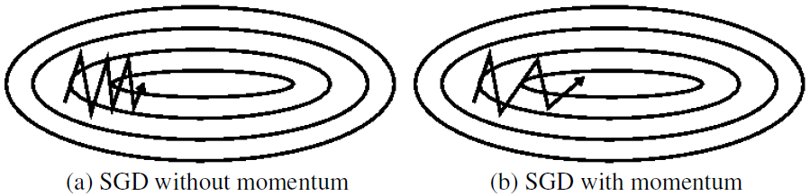
Momentum
SGD oscillates in areas where the surface curves much more steeply (around local optima) (Figure a)
Momentum helps accelerate SGD in the relevant direction and dampens oscillations (Figure b)

Slide 11
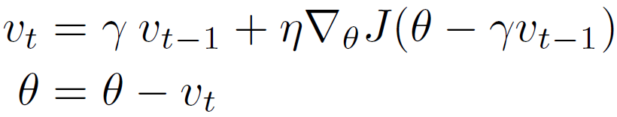
Nesterov accelerated gradient (NAG)
The momentum term ϒ is usually set to 0.9
Effectively look ahead by calculating the gradient not w.r.t. to our current parameters but w.r.t. the approximate future position of our parameters

Slide 12
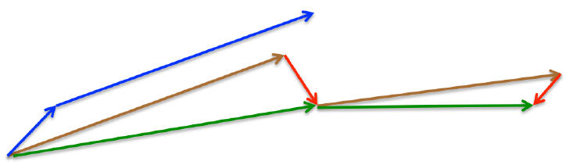
Nesterov accelerated gradient (NAG)
Momentum
  Computes the current gradient (small blue vector in Figure 3)
  Then takes a big jump in the direction of the updated accumulated gradient (big blue vector),
NAG
  Makes a big jump in the direction of the previous accumulated gradient (brown vector)
  Measures the gradient
  Then makes a correction (green vector).
  This anticipatory update prevents us from going too fast and results in increased responsiveness

Slide 13
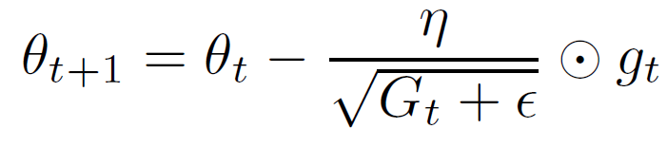
Adaptive Gradients (Adagrad)
g_{t} – Gradient at time t
G_{t} – Sum of the squares of the past gradients w.r.t. to all parameters
Eliminates the need to manually tune the learning rate
  Most implementations use a default value of 0.01

Slide 14
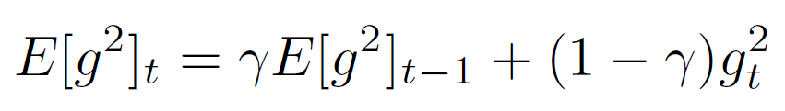
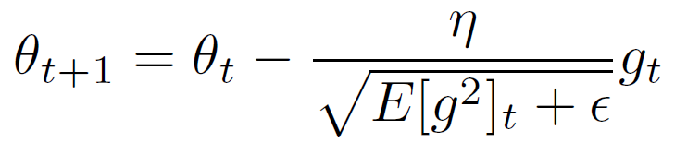
Root Mean Squared Propagation (RMSProp)
The momentum term ϒ is usually set to 0.9
Learning rate η is usually set to 0.001
Removes the monotonicity in the effective learning rate

Slide 15
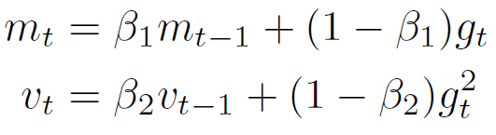
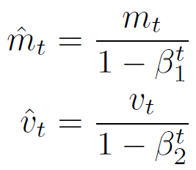
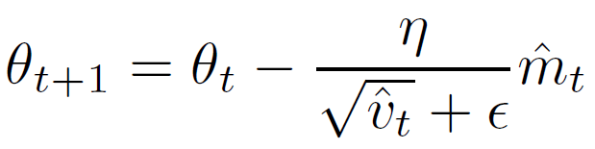
Adaptive Moment Estimation (Adam)
β₁ is set to 0.9
β₂ is set to 0.999
∈ is set to 1e-8
Bias Correction
Update Equation

Slide 16
RMSProp with Nesterov momentum
Try at home!

